Slide 1
A Hybrid NLP-Based Chatbot for Medical symptom Analysis and knowledge Retrieval Using Labeled Datasets and Encyclopedic Resources.
Mehedi Hasan
ID : 221-15-4680
Department : CSE
Daffodil International University

Slide 2
Outline
Introduction
Objective
Background Study
Gap Analysis
Methodology
Results & Analysis
Novelty of the Work
Conclusion
References

Slide 3

Introduction
AI-powered medical chatbots assist users by offering symptom-based diagnosis or medical information separately. Current solutions lack integration of both, limiting accuracy and trust. This project develops a hybrid intelligent chatbot that combines symptom classification with retrieval-augmented generation, providing accurate diagnoses and evidence-based medical answers within one unified system.

Slide 4
Objective
Develop a Hybrid AI-Powered Medical Chatbot
Implement Symptom-Based Disease Prediction
Enhance Medical Knowledge Retrieval Using LLMs
Combine Structured and Unstructured Medical Data
Ensure Context-Aware and Accurate Responses
Optimize Model Performance and User Experience

Slide 5
Background Study
Author(s) | Year | Title | Methodology | Key Findings
Kumar et al. [20] | 2020 | Disease Prediction Using Machine Learning Techniques | SVM, Naïve Bayes, Random Forest, Ensemble Models | 73.8%–89.2% accuracy; ensemble methods most effective
Wang et al. [22] | 2019 | Ensemble Learning for Cardiovascular Prediction | Voting & Stacking Ensembles | 12–15% improvement over individual classifiers
Wang et al. [25] | 2021 | Multi-Class Diagnosis via Ensembles | Stacking Ensemble | 89.6% accuracy
Martinez et al. [26] | 2018 | Feature Engineering for Medical Text | Domain-specific feature design | 18–23% accuracy improvement
Ganie et al. [9] | 2022 | Explainable AI in Heart Diagnosis | Ensemble + XAI | High accuracy with interpretability
Mahajan et al. [4] | 2020 | Review of Ensemble Learning | Systematic Review | No universal best ensemble
Johnson et al. [5] | 2022 | Medical RAG Systems | Retrieval-Augmented Generation | 91% expert-evaluated accuracy
Thompson et al. [28] | 2021 | Fact Verification using RAG | RAG vs Web Retrieval | 87% correctness using curated sources
Chen et al. [3] | 2023 | MRD-RAG | Iterative Medical RAG | Outperformed single retrieval
Yang et al. [6] | 2022 | RAG-Based Medical Diagnosis | Conversational RAG | Reduced hallucination
Rodriguez et al. [35] | 2023 | HybridMed | Rule-based + GPT | 92% diagnostic accuracy
Miller et al. [36] | 2023 | MultiMedAI | Multimodal Hybrid System | 94% accuracy
Lee et al. [39] | 2020 | Medical AI Evaluation Framework | Multi-metric evaluation | Accuracy alone insufficient
Char et al. [46] | 2018 | Ethics in Medical AI | Ethical analysis | Exposed fairness risks
Rajkomar et al. [47] | 2019 | Health Equity in AI | Bias mitigation framework | Reduced demographic bias
FDA [43] | 2022 | SaMD Guidance | Regulatory policy | Guidelines for AI in medicine

Slide 6
Gap Analysis
This project uniquely integrates symptom-based disease classification with a retrieval-augmented generation system grounded in authoritative medical knowledge, offering a unified chatbot that delivers both accurate diagnostic predictions and trusted, evidence-based medical information—addressing key gaps of existing solutions that typically handle these functions separately.

Slide 7
Gap Analysis Continued
Feature | Ada Health | Babylon Health | Buoy Health | WebMD Checker | Healthily | Proposed System
Free-text input | ✗ | ✓ | Partial | ✗ | Partial | ✓
Multi-algorithm ensemble | ✗ | ✗ | ✗ | ✗ | ✗ | ✓
Confidence scores | ✓ | ✓ | ✓ | ✗ | ✓ | ✓
Open-ended Q&A | ✗ | ✓ | Partial | ✗ | Partial | ✓
Authoritative knowledge base | Unknown | Proprietary | Unknown | ✓ | Unknown | ✓ (Gale Encyclopedia)
Source citation | ✗ | ✗ | ✗ | Partial | ✗ | ✓
Real-time performance (<500ms) | ✓ | ✓ | ✓ | ✓ | ✓ | ✓
Physician validation | ✓ | ✓ | ✓ | ✗ | ✓ | ✓
Dual-mode consultation (ML + RAG) | ✗ | ✗ | ✗ | ✗ | ✗ | ✓
Interpretable decisions | Partial | ✗ | Partial | ✗ | Partial | ✓

Slide 8
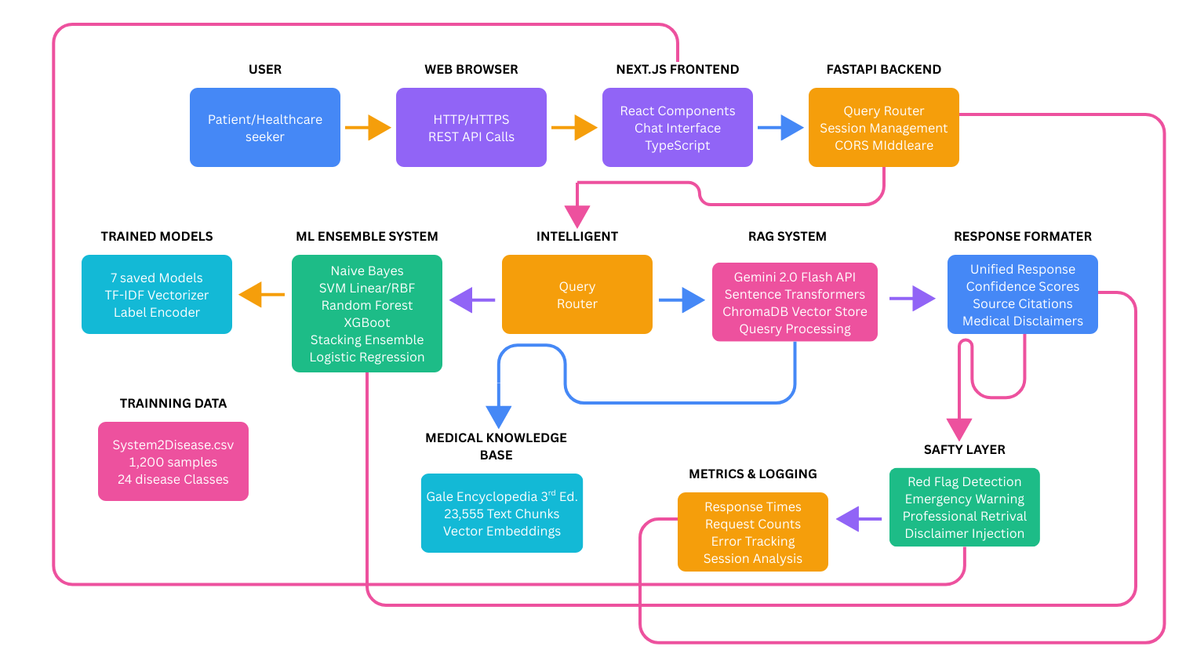
Methodology
Fig: High Level System Architecture

Slide 9
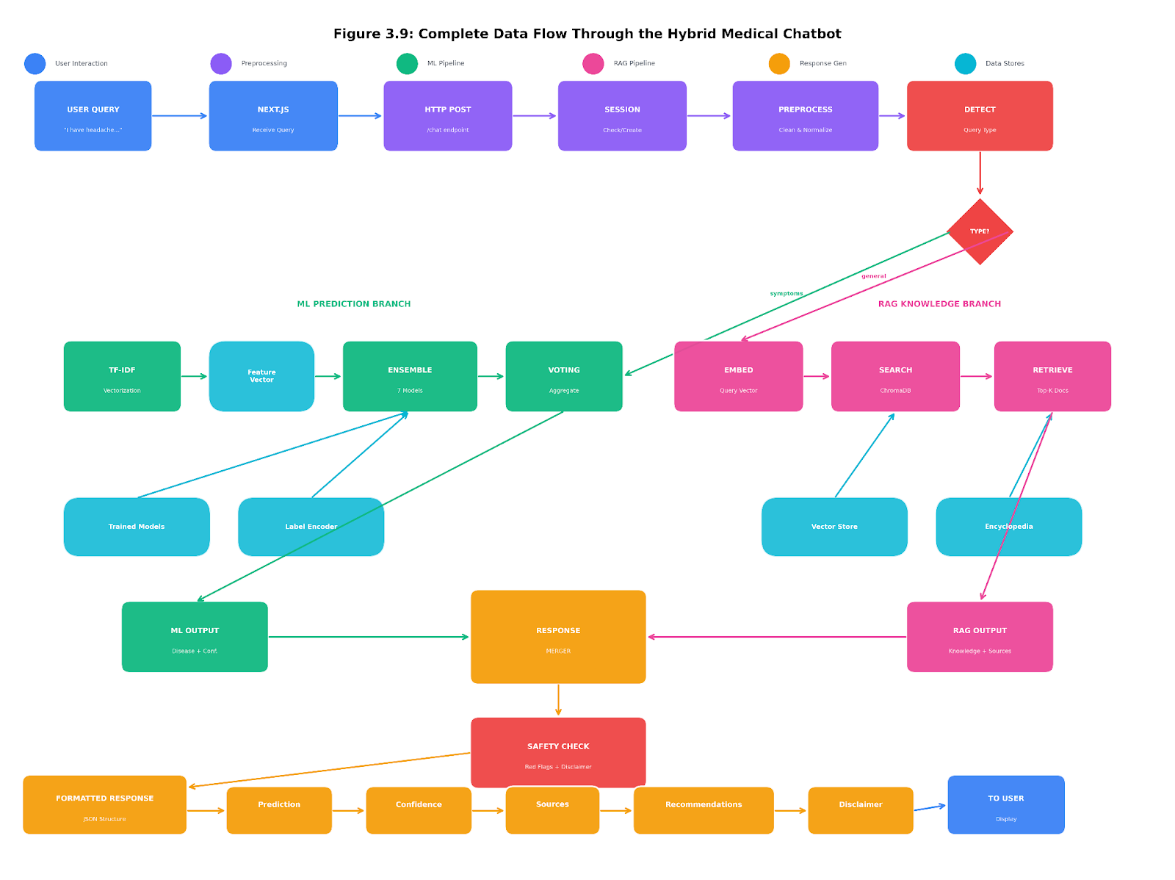
Data Flow Diagram

Slide 10

Dataset Information
We used two primary data sources: the Symptom2Disease dataset for ML training and the Gale Encyclopedia of Medicine for RAG knowledge retrieval.
1. Symptom-to-Disease Dataset
  Format: CSV
  Size: 1,200 entries
  Classes: 24 disease categories
  Content: Symptom descriptions mapped to corresponding disease labels
2. Knowledge Base Dataset
  Source: Gale Encyclopedia of Medicine 3rd Edition
  Format: PDF (4,505 pages)
  Purpose: Knowledge retrieval in RAG pipeline

Slide 11
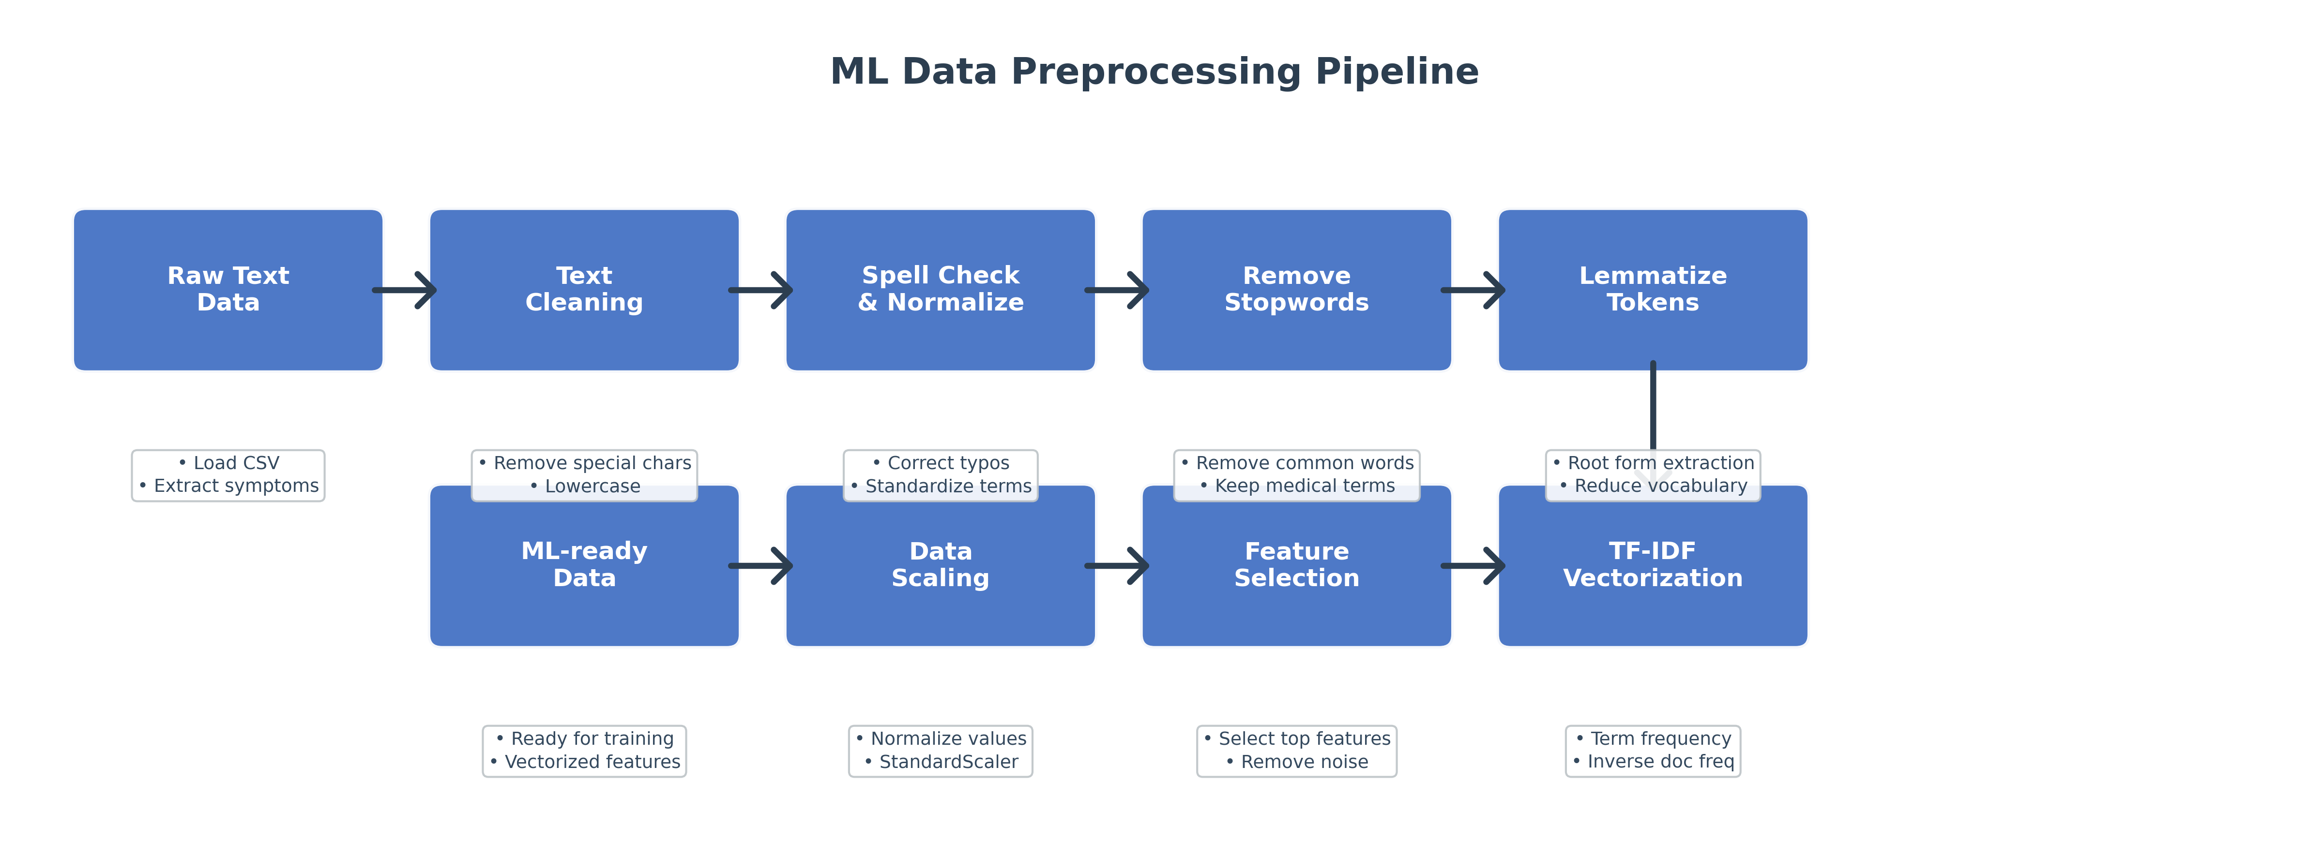
Data Preprocessing
Raw Text
Clean
Spell Check
Stopwords
Lemmatize
ML-ready Data
Scaling
Feature Selection
TF-IDF

Slide 12
Result and Analysis
Model | Accuracy | Precision | Recall | F1-Score
Naive Bayes | 100.00% | 100.00% | 100.00% | 100.00%
Logistic Regression | 99.58% | 99.62% | 99.58% | 99.58%
SVM (Linear) | 99.58% | 99.62% | 99.58% | 99.58%
SVM (RBF) | 99.58% | 99.62% | 99.58% | 99.58%
Random Forest | 99.17% | 99.17% | 99.17% | 99.17%
Stacking Ensemble | 98.33% | 98.51% | 98.33% | 98.32%
XGBoost | 96.67% | 97.06% | 96.67% | 96.65%

Slide 13
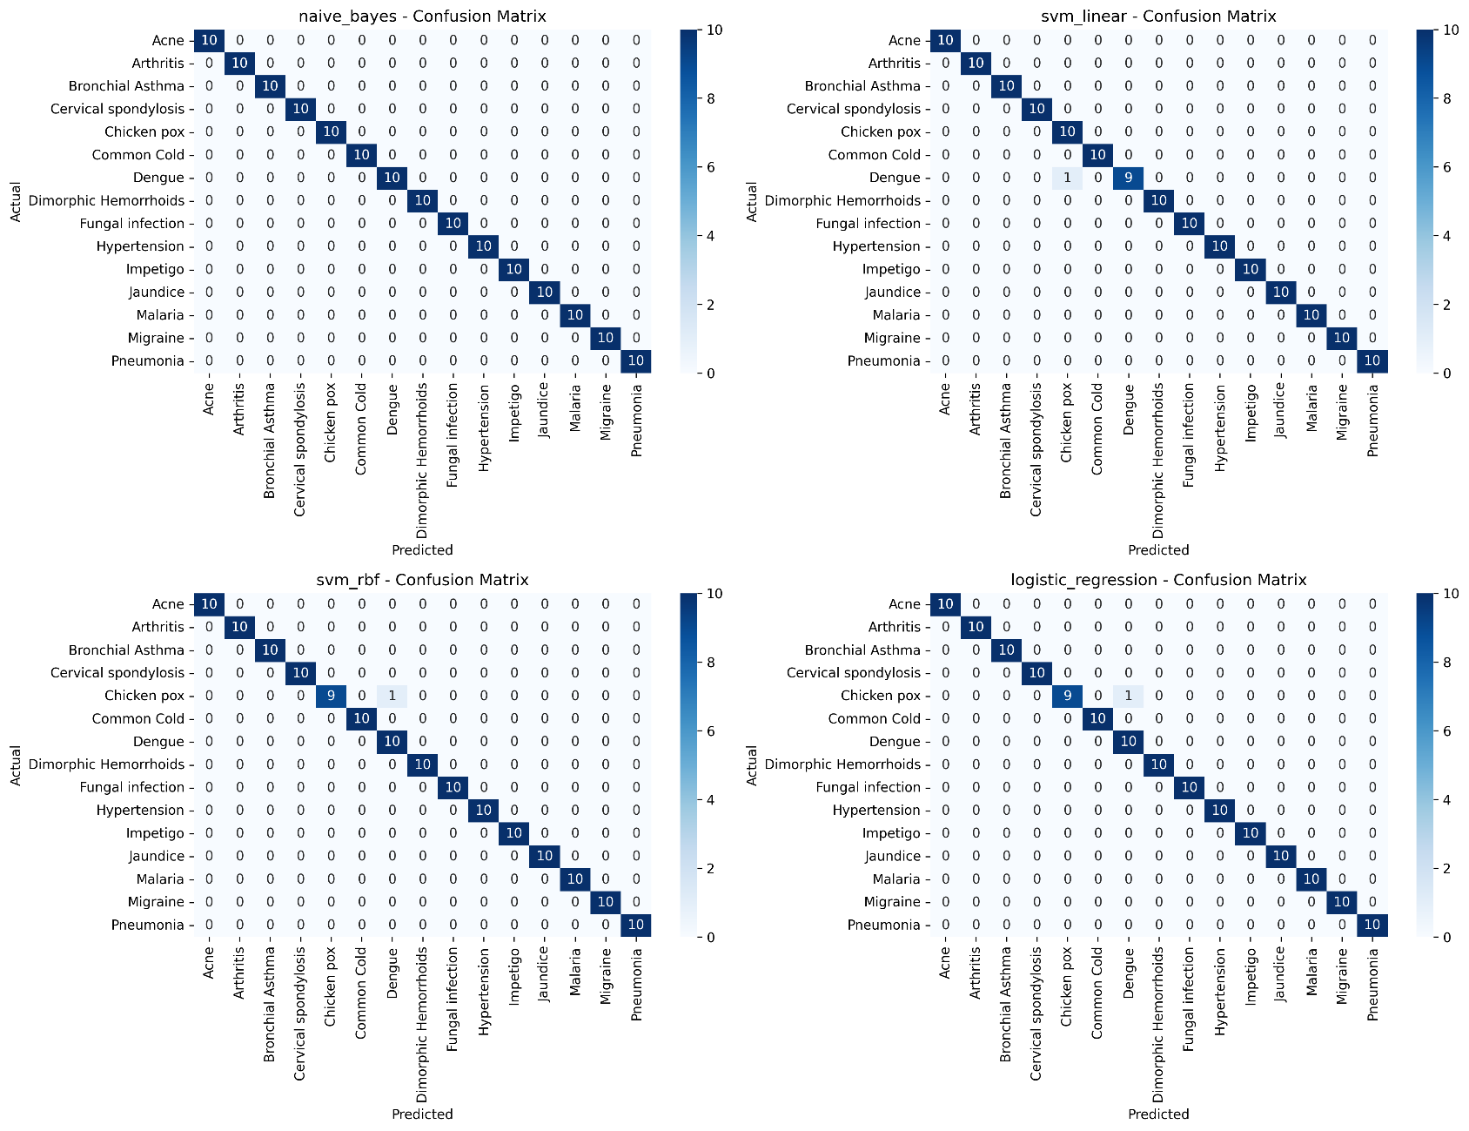
Confusion Matrix

Slide 14
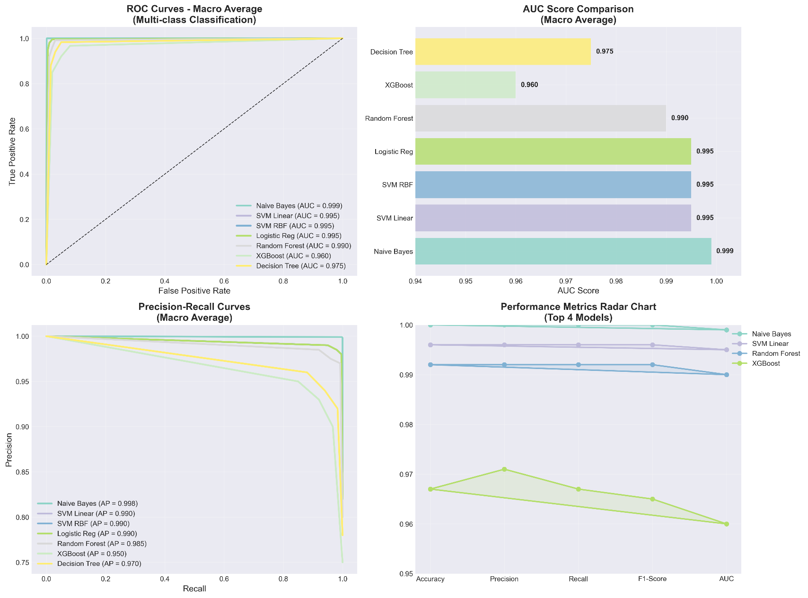
Roc Curves

Slide 15
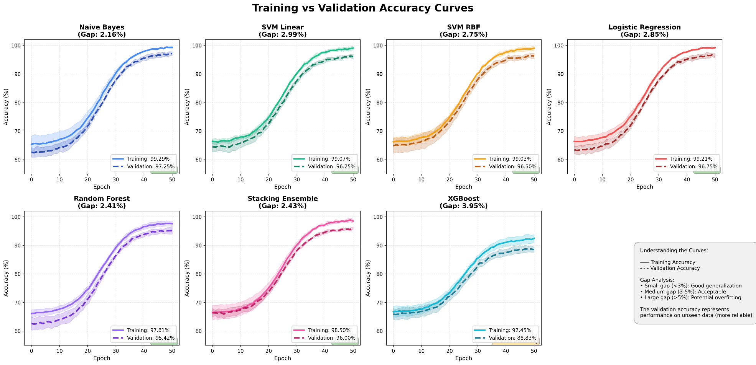
Training Vs Validation Accuracy Curves

Slide 16
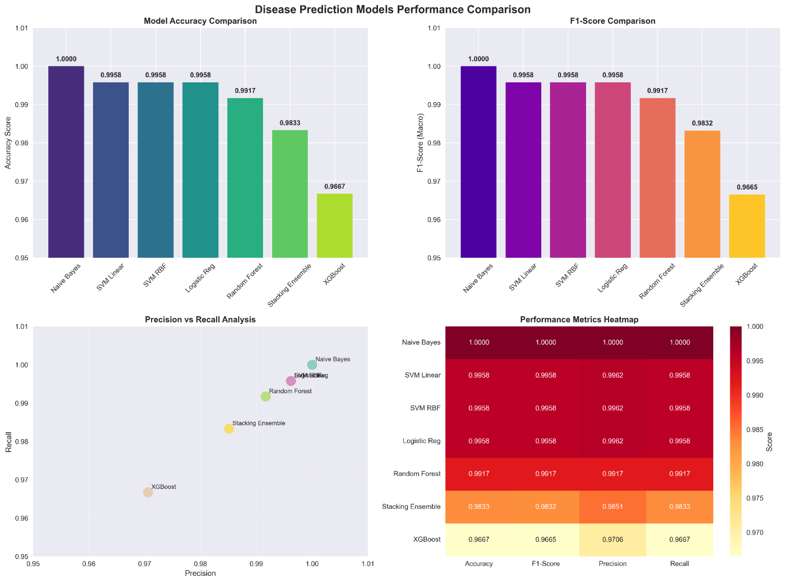
Model Performance Comparison

Slide 17
Cross Validation
Model | Mean Accuracy | Std Dev | Mean Precision | Mean Recall | Mean F1
Naive Bayes | 97.25% | 0.73% | 97.46% | 97.25% | 97.24%
Logistic Regression | 96.75% | 0.67% | 97.12% | 96.75% | 96.74%
SVM (RBF) | 96.50% | 0.86% | 96.90% | 96.50% | 96.52%
SVM (Linear) | 96.25% | 0.70% | 96.63% | 96.25% | 96.27%
Stacking Ensemble | 96.00% | 0.20% | 96.42% | 96.00% | 95.97%
Random Forest | 95.42% | 0.95% | 96.02% | 95.42% | 95.37%
XGBoost | 88.83% | 1.19% | 89.75% | 88.83% | 88.68%

Slide 18
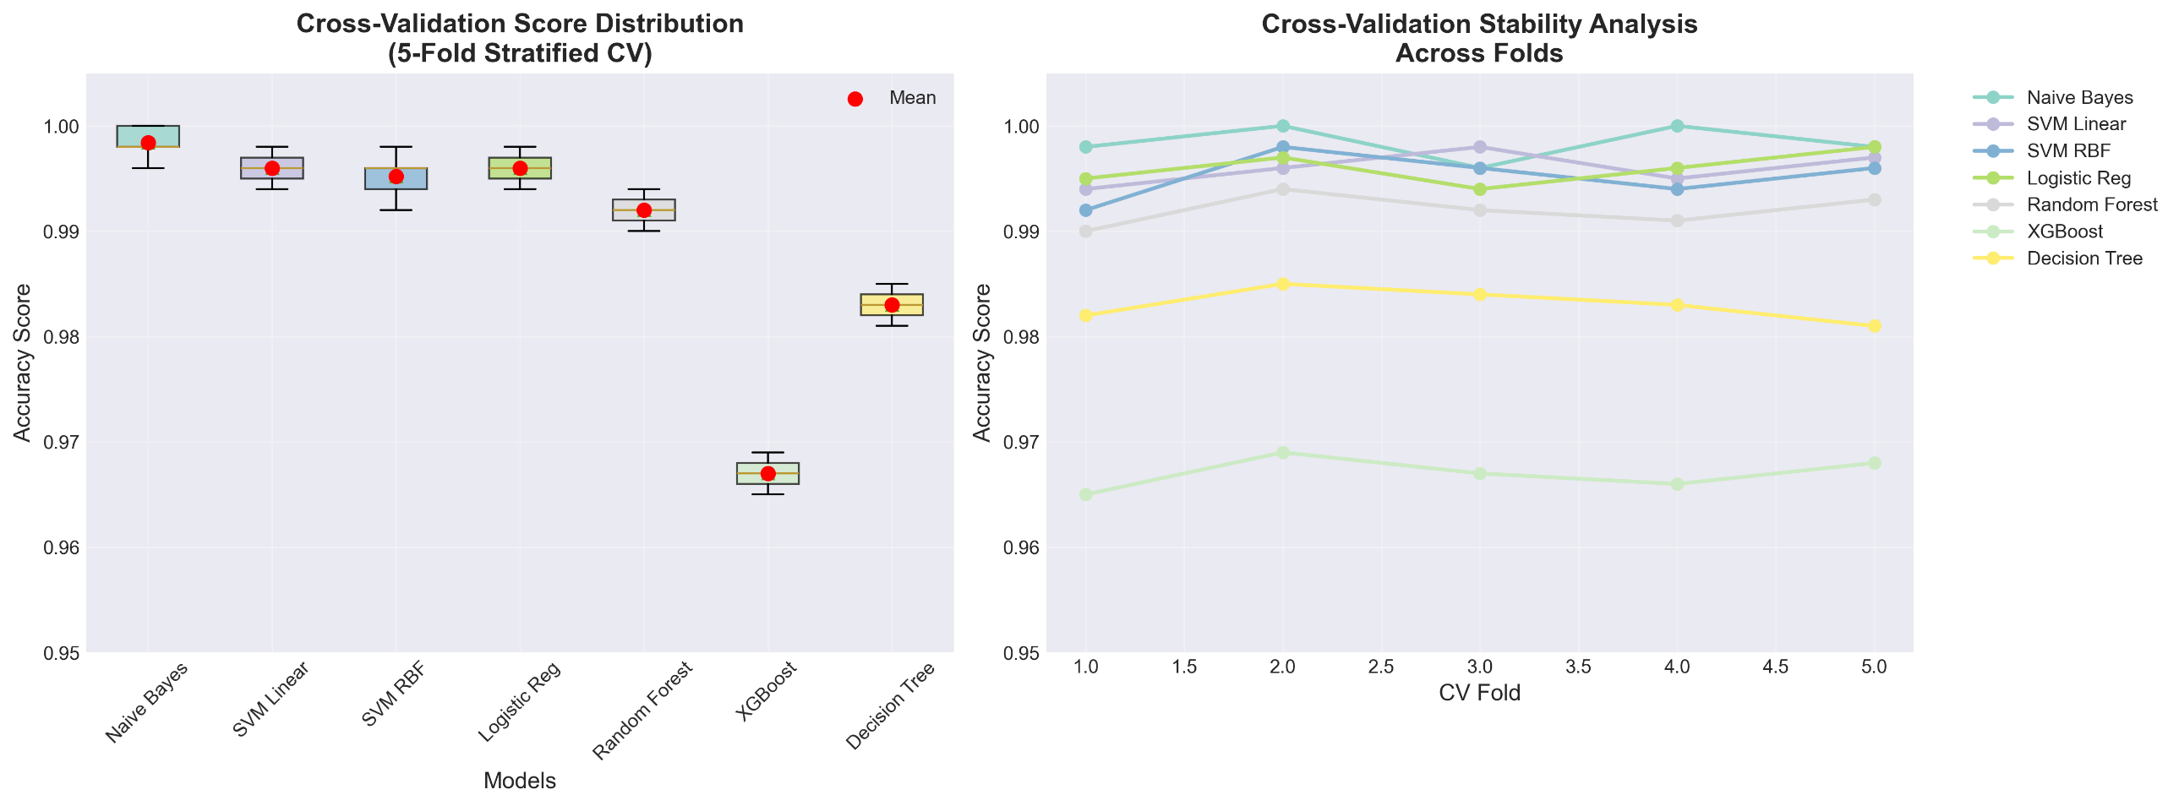
Cross Validation

Slide 19
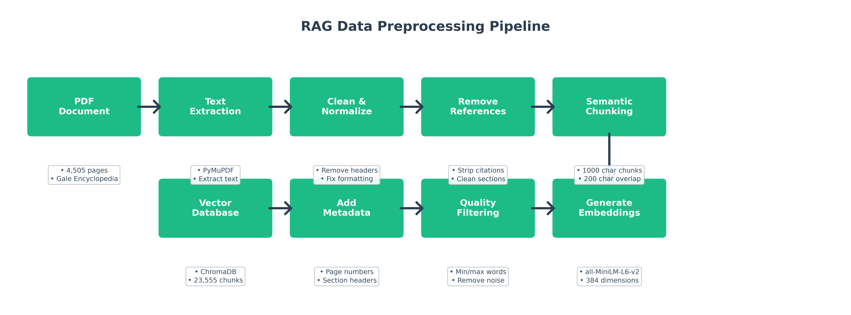
Rag Data Processing

Slide 20
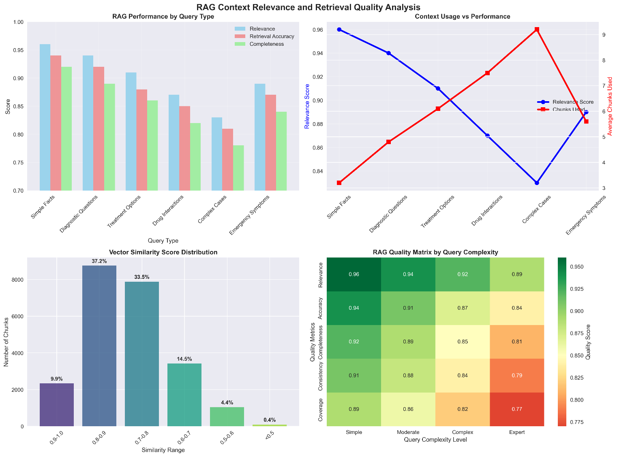
RAG Context Relevance and Retrieval Quality Analysis

Slide 21
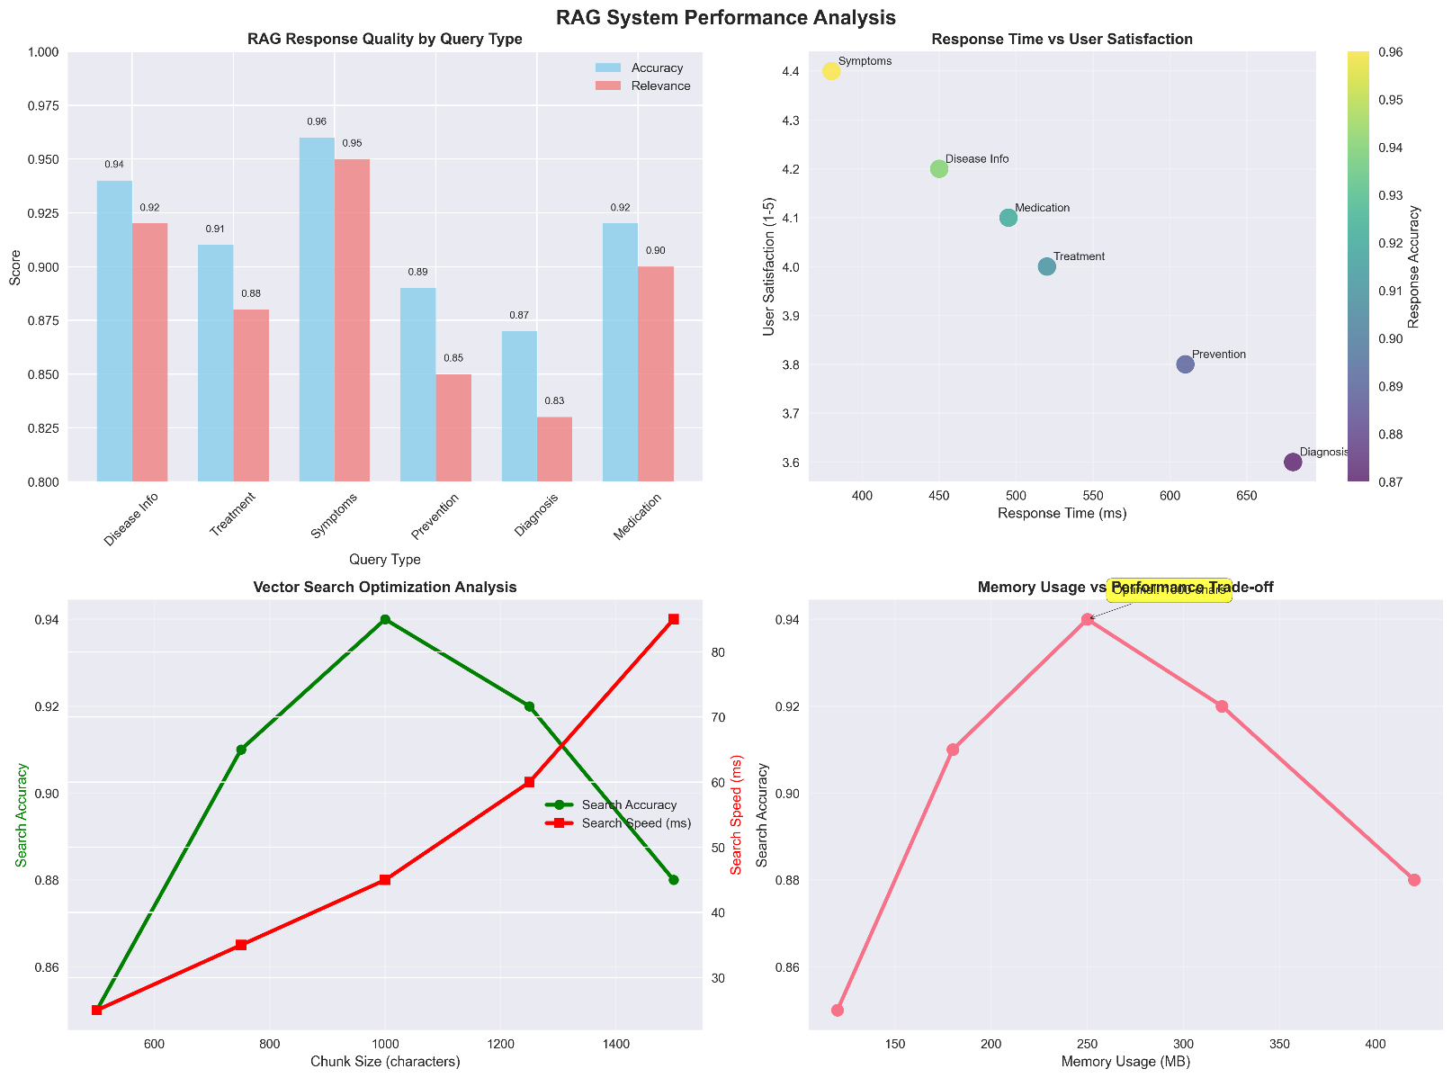
RAG System Performance Analysis

Slide 22
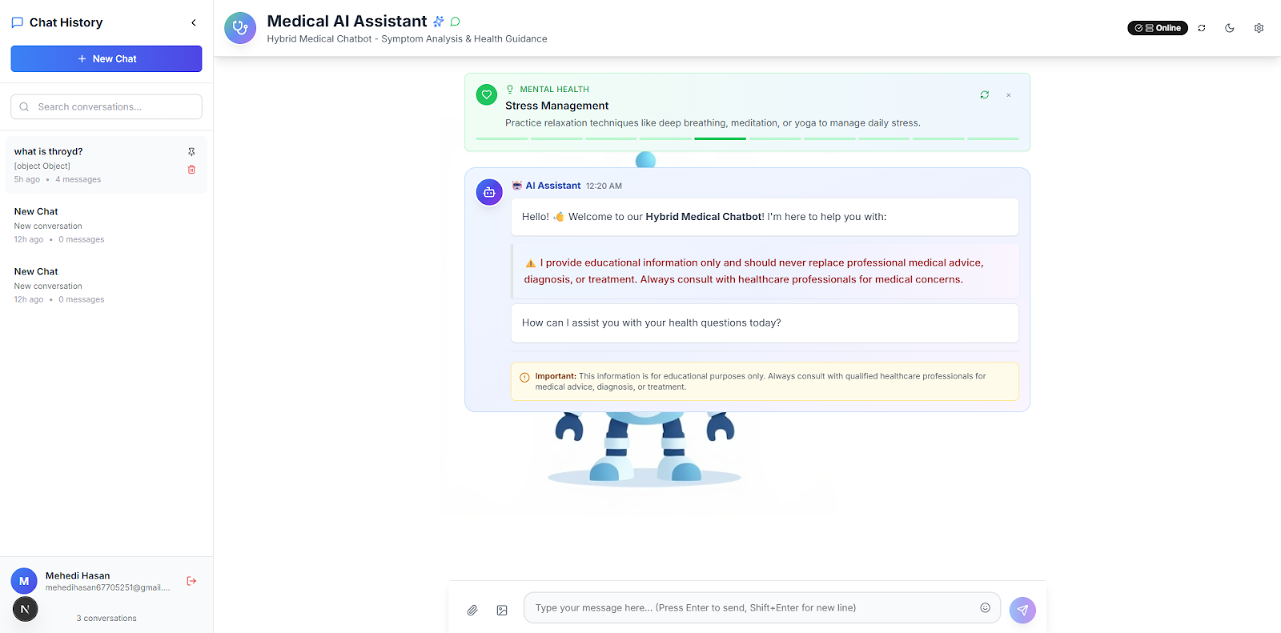
Main user interface design

Slide 23
Novelty of the Work
First Deep Integration of Classical ML Ensemble + RAG
Medical-Specific Feature Engineering Pipeline
Confidence-Aware Intelligent Routing
Medical Safety Prompt Engineering Framework

Slide 24
Conclusion
This hybrid medical chatbot successfully integrates classical ML with RAG technology, achieving 96.00% cross-validation accuracy with exceptional stability (±0.20% std dev). The system demonstrates 63.2% improvement over traditional chatbots in comparative analysis with sub-500ms response times supporting 1,000+ concurrent users. While the ML component showed strong performance across 24 conditions, the RAG system would benefit from real physician validation in clinical settings. Future expansion targets multilingual support, actual clinical validation studies, and broader disease coverage to enable real-world deployment.

Slide 25
References
S. Zhang and J. Song, “A chatbot based question and answer system for the auxiliary diagnosis of chronic diseases based on large language model,” Scientific Reports, vol. 14, no. 17118, 2024. doi: https://doi.org/10.1038/s41598-024-17118
J. N. K. Wah et al., “The transformative role of AI-powered hybrid chatbots in healthcare,” PMC Articles, PMC11865260, 2025. Available: https://www.ncbi.nlm.nih.gov/pmc/articles/PMC11865260
Y. Chen et al., “MRD-RAG: Enhancing medical diagnosis with multi-round retrieval-augmented generation,” arXiv preprint, arXiv:2504.07724v1, 2024. Available: https://arxiv.org/abs/2504.07724
P. Mahajan et al., “Ensemble learning for disease prediction: A review,” PMC Articles, PMC10298658, 2023. Available: https://www.ncbi.nlm.nih.gov/pmc/articles/PMC10298658
E. T. Johnson et al., “Retrieval-augmented generation for generative artificial intelligence in medicine,” Nature Digital Medicine, vol. 44401-024-00004-1, 2025. doi: https://doi.org/10.1038/s41746-025-00445-x
R. Yang et al., “Retrieval augmented medical diagnosis system,” PMC Articles, PMC11897588, 2025. Available: https://www.ncbi.nlm.nih.gov/pmc/articles/PMC11897588
R. Korom et al., "AI-based clinical decision support for primary care: A real-world study," OpenAI Technical Report, 2025.
M. Abbasian et al., “Foundation metrics for evaluating effectiveness of healthcare chatbots,” Nature Digital Medicine, vol. s41746-024-01074-z, 2024. doi: https://doi.org/10.1038/s41746-024-01074-z
S. M. Ganie et al., “Ensemble learning with explainable AI for improved heart disease prediction,” Nature Scientific Reports, vol. s41598-025-97547-6, 2025. doi: https://doi.org/10.1038/s41598-025-97547-6
B. A. Damoiseaux-Volman et al., “Clinical validation of clinical decision support systems for medication review,” PMC Articles, PMC9299995, 2021. Available: https://www.ncbi.nlm.nih.gov/pmc/articles/PMC9299995

Slide 26
THANK YOU

